Slide 1
Moment for Mission

Slide 2
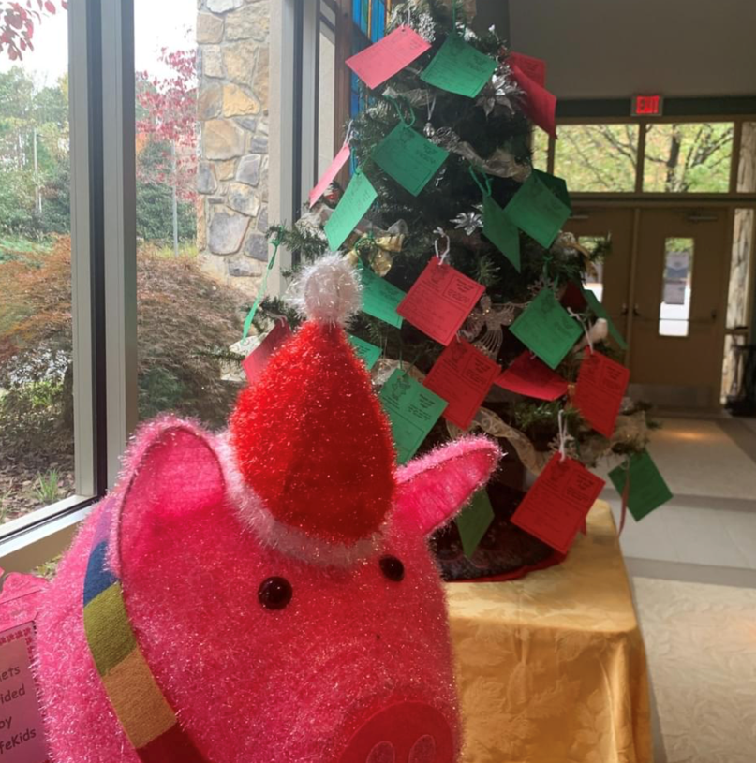
Santa’s Caravan
Notes:
While Santa’s Caravan is largely only visible at the end of the year as we approach the holiday season, in reality, it is a program that requires coordination, support, and volunteers throughout the year.

Slide 3
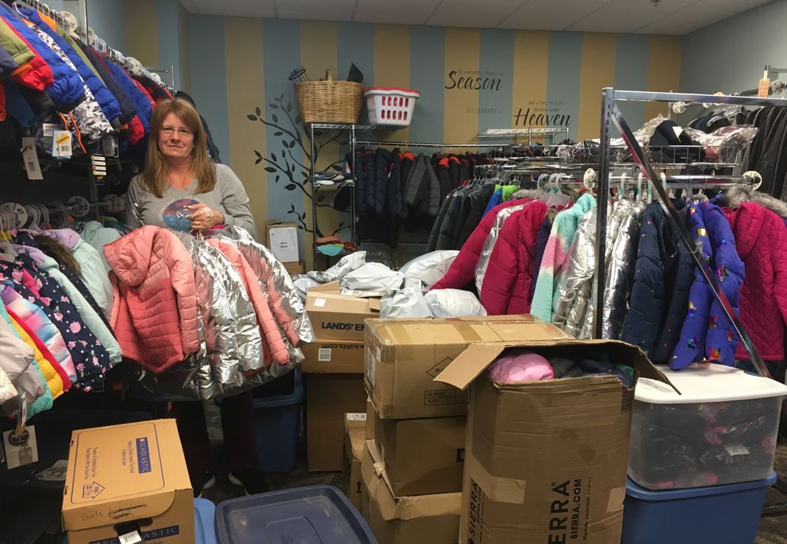
Santa’s Caravan
Program provides families with:
Food during the holiday season
Coats, gloves, hats
Toiletries, diapers
Gifts

Slide 4
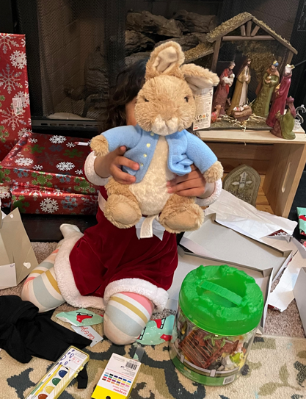
Santa’s Caravan
Need continues to grow each year:
2018 – 157 children
2019 – 167 children
2020 – 193 children
2021 – 220 children
Notes:
The families served are identified through several means:
Many are identified through local school counselors who are aware of family living conditions and situations that may challenge the ability of that child to have a meaningful Christmas experience.

Slide 5
Santa’s Caravan Annual Schedule
Dec. 26 – Jan: Clearance items/closeout last season
Feb/March: Clearance jackets/gloves/coats, begin next season
July/Aug: Reach out to counselors/orgs to identify need
Sept/Oct: Organize food boxes/schedule family interviews. Finalize paperwork for current season
Notes:
Continually throughout the year:
1. Search for financial supporters, fundraising opportunities, and volunteers.
2. Follow up with certain families to let them that know they are not forgotten.
Dec 26 throughout January: 1. Search for wrapping supplies on clearance.
2. Search for toys and toiletries on clearance.
3. Inventory and organize coats, hats, and gloves.
4. Sort and organize ALL supplies to store for the coming season.
5. Meet with volunteers to evaluate past season and to organize and restructure coming season.
6. Organize and count underwear and sock inventory
7. Create budget for coming year.
8. Create calendar for coming year.
February - March:
1. Search for coats, hats, and gloves at clearance prices for next year’s angels. Organize.
2. Begin administrative tasks for reorganizing program for next year.
July/August:
1. Prepare paperwork for coming season.
2. Reach out to counselors first week of school.
3. Deliver all paperwork for Phase 1 of program.
4. Reach out to miscellaneous families and organizations that might know of families in need.
5. Push to finalize volunteers for specific roles.
6. Reaching out to outside organizations for volunteers, people to adopt families, facilities to place angel trees, etc.
September - October:
1. Continue search for volunteers and finalize volunteer assignments.
2. Finalize all paper work and procedures for the season. (This is a LOT!)
3. Set up spaces for interviews. (Coat shopping, interview areas, coat and underwear room, snack and waiting areas, volunteer meals, etc.)
4. Work with Andrea and food pantry to get food orders set up for October and December food give-aways.
5. Work with outside businesses to get food boxes donated. (~320 boxes)
6. Fill food boxes for October food give-away.
7. Organize the food for each family for the October give-away.
October - December
1. All volunteers should be placed, but it is always necessary to find replacements as we go.
2. Administrative tasks: Organize and assign all families to our many and varied ways to fund their Christmases.
3. Conducting interviews over the phone and in person.
4. Make-up interviews.
5. Create Amazon wishlists and constantly update and evaluate the lists.
6. Reaching back out to various organizations with their assignments.
7a. Making shopping lists.
7b. Making tags.
8. Placing the gifts that have been purchased early.
9a. Placing all toiletries.
9b. Fill the food boxes for December’s giveaway.
10. Shopping, shopping, shopping and labeling EVERYTHING!
11. Sorting, boxing, and more labeling the gifts from all of the variety of donors.
12a. Monitoring the “Bag Room,” where all gifts are sorted and proofread yet again before the final inventory and going into the final (blue) family bag.
12b. Move and set up all the tables and chairs owned by the church for creation of the North Pole. Move every gift upstairs and place at the exact correct spot indicated for specific angel #.
13. Individually looking at EACH families' final gifts 2-3 times to ensure that sizes are correct, styles match the request, toys suit the child’s interests, and that each sibling has an equal amount of “happy” being delivered.
14. Wrapping gifts.
15. Bagging and labeling gifts for delivery or pick up.
16. Creating schedules for pick up.
17. Creating routes and maps for delivery.
18. Delivering gifts to certain families.
19. Staffing pick-up of the gifts and food for several families.
20. Clean up and break down the North Pole.

Slide 6
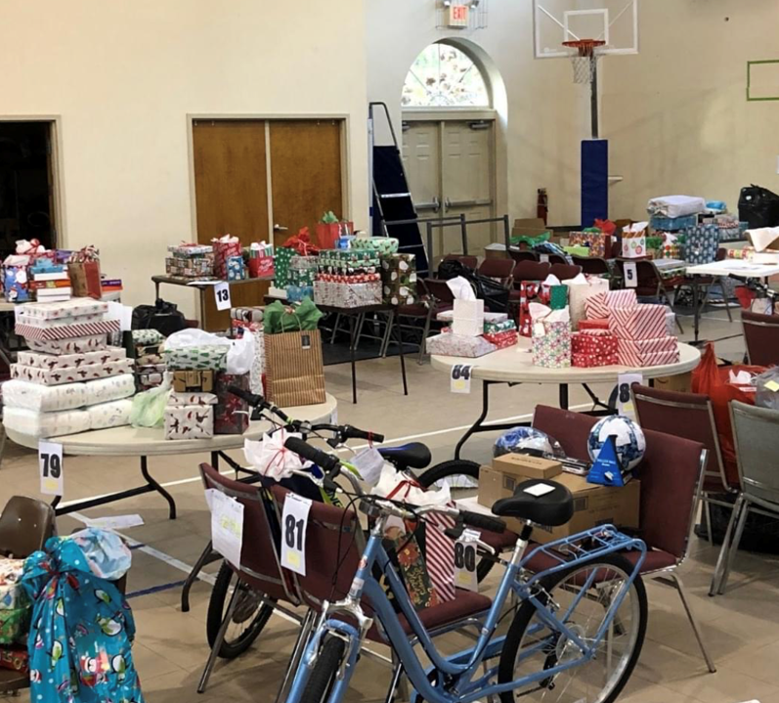
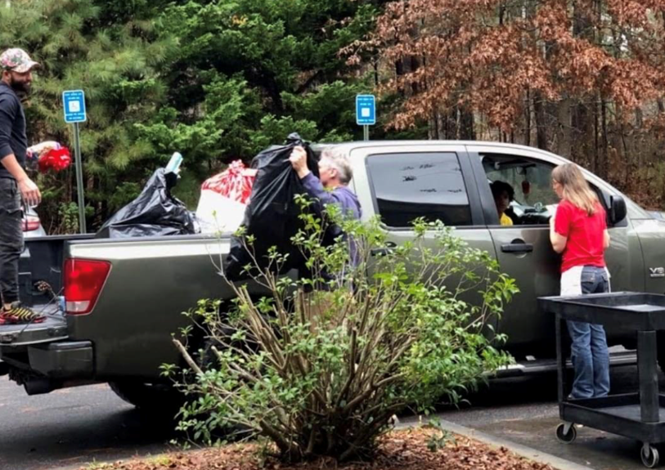
October thru December
Conduct interviews,
Develop wish-lists
Organize gifts/North Pole
Distribution
Deliveries where needed
Notes:
Continually throughout the year:
1. Search for financial supporters, fundraising opportunities, and volunteers.
2. Follow up with certain families to let them that know they are not forgotten.
Dec 26 throughout January: 1. Search for wrapping supplies on clearance.
2. Search for toys and toiletries on clearance.
3. Inventory and organize coats, hats, and gloves.
4. Sort and organize ALL supplies to store for the coming season.
5. Meet with volunteers to evaluate past season and to organize and restructure coming season.
6. Organize and count underwear and sock inventory
7. Create budget for coming year.
8. Create calendar for coming year.
February - March:
1. Search for coats, hats, and gloves at clearance prices for next year’s angels. Organize.
2. Begin administrative tasks for reorganizing program for next year.
July/August:
1. Prepare paperwork for coming season.
2. Reach out to counselors first week of school.
3. Deliver all paperwork for Phase 1 of program.
4. Reach out to miscellaneous families and organizations that might know of families in need.
5. Push to finalize volunteers for specific roles.
6. Reaching out to outside organizations for volunteers, people to adopt families, facilities to place angel trees, etc.
September - October:
1. Continue search for volunteers and finalize volunteer assignments.
2. Finalize all paper work and procedures for the season. (This is a LOT!)
3. Set up spaces for interviews. (Coat shopping, interview areas, coat and underwear room, snack and waiting areas, volunteer meals, etc.)
4. Work with Andrea and food pantry to get food orders set up for October and December food give-aways.
5. Work with outside businesses to get food boxes donated. (~320 boxes)
6. Fill food boxes for October food give-away.
7. Organize the food for each family for the October give-away.
October - December
1. All volunteers should be placed, but it is always necessary to find replacements as we go.
2. Administrative tasks: Organize and assign all families to our many and varied ways to fund their Christmases.
3. Conducting interviews over the phone and in person.
4. Make-up interviews.
5. Create Amazon wishlists and constantly update and evaluate the lists.
6. Reaching back out to various organizations with their assignments.
7a. Making shopping lists.
7b. Making tags.
8. Placing the gifts that have been purchased early.
9a. Placing all toiletries.
9b. Fill the food boxes for December’s giveaway.
10. Shopping, shopping, shopping and labeling EVERYTHING!
11. Sorting, boxing, and more labeling the gifts from all of the variety of donors.
12a. Monitoring the “Bag Room,” where all gifts are sorted and proofread yet again before the final inventory and going into the final (blue) family bag.
12b. Move and set up all the tables and chairs owned by the church for creation of the North Pole. Move every gift upstairs and place at the exact correct spot indicated for specific angel #.
13. Individually looking at EACH families' final gifts 2-3 times to ensure that sizes are correct, styles match the request, toys suit the child’s interests, and that each sibling has an equal amount of “happy” being delivered.
14. Wrapping gifts.
15. Bagging and labeling gifts for delivery or pick up.
16. Creating schedules for pick up.
17. Creating routes and maps for delivery.
18. Delivering gifts to certain families.
19. Staffing pick-up of the gifts and food for several families.
20. Clean up and break down the North Pole.

Slide 7
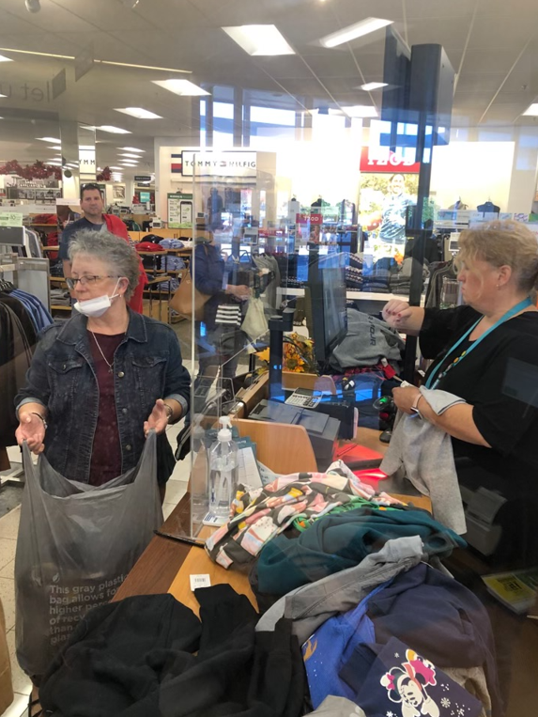
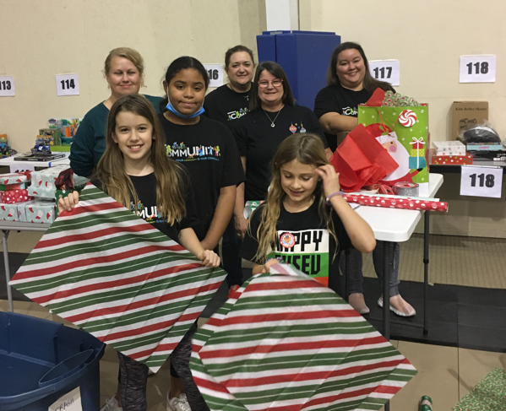
Volunteers

Slide 8
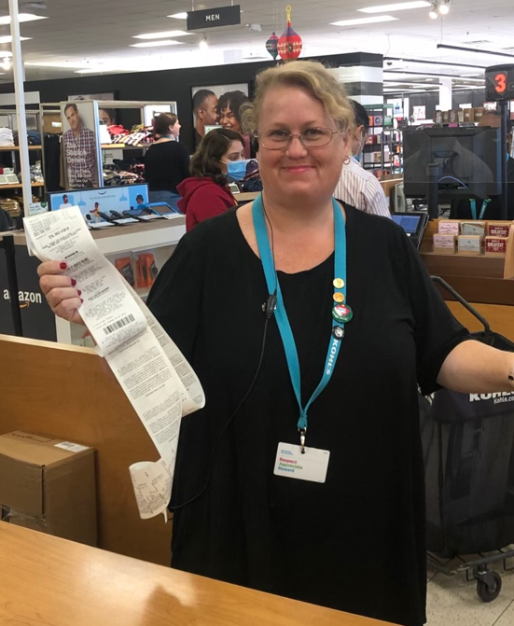
Ways to Serve
Amazon Wish Lists
Kohl’s Cash!
Adopting a child or family
Time! Bring friends and family onboard! Help is needed year-round!
Notes:
1. Financial donations through the church by way of check, gift cards, online, and ? 2. Amazon Wish List 2x a year. One for gifts and one currently posted now for hats and gloves.
3. Buying clearance items such as toys, toiletry gift sets, and wrapping paper, bags, bows, boxes, etc after the holidays.
4. Buying clearance coats in babies, boys and girls sizes and lined zip up hoodies for teens in adult sizes in Feb/March. Also, hats and gloves are collected.
5. Using your extra Kohls cash or other store member points to buy either warm outerwear on clearance or socks and underwear throughout the year.
6. Adopting a child or family during the holiday season.
7. New, more “hip” methods of donating are being worked on.
8. DONATING YOUR TIME AND BRINGING YOUR FRIENDS OR ADULT CHILDREN ONBOARD!!

Slide 9
Jay Weaver Food Pantry

Slide 10
Jay Weaver Emergency Food Pantry – Years At a Glance (2020)
Notes:
When the pandemic began to set in in March and April 2020, our volunteers leapt into action, quickly shifting from monthly to instead weekly distributions. The amount of children, families and seniors served by the Food Pantry program rapidly increased during the pandemic. The amount of food distributed each month jumped from just under 4,000 lbs/month to 35,000 lb/month. In 2020 and 2021, each, our volunteers delivered over 200 tons of food were delivered to the community.

Slide 11
Jay Weaver Emergency Food Pantry – Years At a Glance (2021)

Slide 12
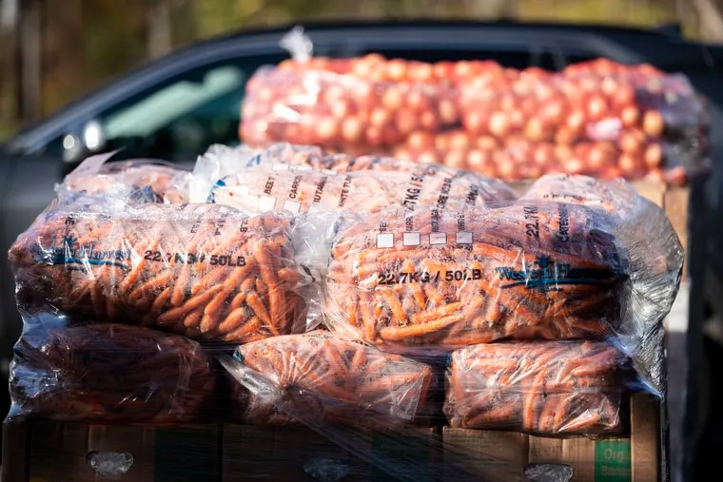
Our Clients
The Jay Weaver Emergency Food Pantry began a weekly Drive Thru Emergency Food Pantry in response to the COVID 19 pandemic in the middle of March 2020. The drive thru pantry serves our neighbors in Cherokee County, but also others from surrounding counties.
We provide food relief services to anyone in need;
Those who have experienced financial difficulties as a result of the COVID-19 crisis.
Families that have increased demands due to additional children or family members at home.
Experiencing job loss or reduction of income.
Increased medical expenses.
Death of family members.
Those with continued loss or lack of income.
Notes:
The majority of the families we serve are in low to moderate income levels (LMI) and appear to come from all ethnicities and types of families; a good number are without English as their primary language. We are also serving families of children receiving free and reduced meals at school, who we serve through weekend food bags at our school pantries.

Slide 13
2020
Jay Weaver Emergency Food Pantry – Years At a Glance
2021
Month | Families | Children | Adults | Seniors | Pounds
January | 24 | 39 | 62 | 2 | 3,834
February | 25 | 32 | 68 | 0 | 3,753
March | 119 | 906 | 1,207 | 144 | 36,767
April | 170 | 327 | 72 | 428 | 17,355
May | 163 | 262 | 469 | 101 | 13,455
June | 172 | 297 | 463 | 86 | 17,150
July | 452 | 781 | 1,208 | 245 | 51,080
August | 279 | 413 | 744 | 186 | 39,483
September | 423 | 613 | 1,131 | 292 | 50,710
October | 392 | 1,053 | 642 | 222 | 47,897
November | 384 | 561 | 1,053 | 212 | 51,260
December | 574 | 923 | 1,412 | 266 | 66,334
Totals | 3,177 | 6,207 | 8,531 | 2,184 | 399,079
Month | Families | Children | Adults | Seniors | Pounds
January | 370 | 554 | 1,033 | 245 | 41,525
February | 397 | 590 | 1,114 | 236 | 43,627
March | 366 | 528 | 1,009 | 241 | 32,770
April | 311 | 460 | 878 | 212 | 29,146
May | 259 | 379 | 701 | 177 | 26,355
June | 325 | 450 | 946 | 218 | 32,526
July | 292 | 399 | 842 | 203 | 27,552
August | 312 | 351 | 887 | 219 | 28,862
September | 383 | 447 | 1,082 | 287 | 32,152
October | 380 | 413 | 1,057 | 274 | 30,795
November | 451 | 532 | 1,183 | 284 | 37,612
December | 457 | 590 | 1,245 | 302 | 46,477
Totals | 4,303 | 5,693 | 11,977 | 2,898 | 409,398

Slide 14
Food Mission Client Monthly Totals

Slide 15
Food Mission Pounds Distributed Monthly Totals

Slide 16
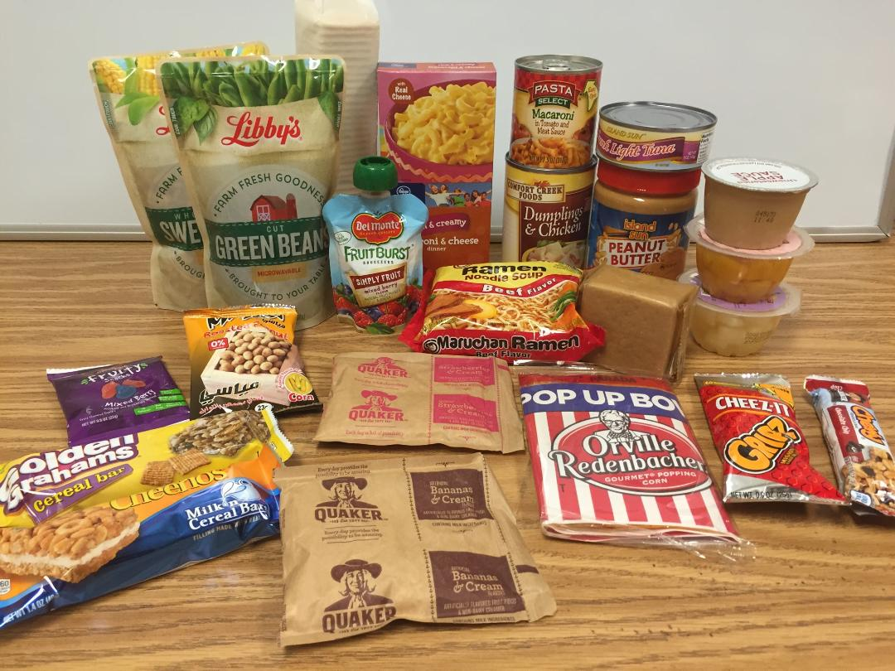
School Pantry – Weekend Bag Program
Sample Weekend Bag
5 - 9 pounds of food
The school pantry weekend bag program continues to serve students in both the Etowah and Woodstock School Zones.
Food bags are provided to students faced with food insecurity over the weekend when school meal programs are not available.
Currently, an average of 350 bags are sent home in students backpacks averaging 85,000 pounds each year. This includes service to 8 schools located in our community.

Slide 17
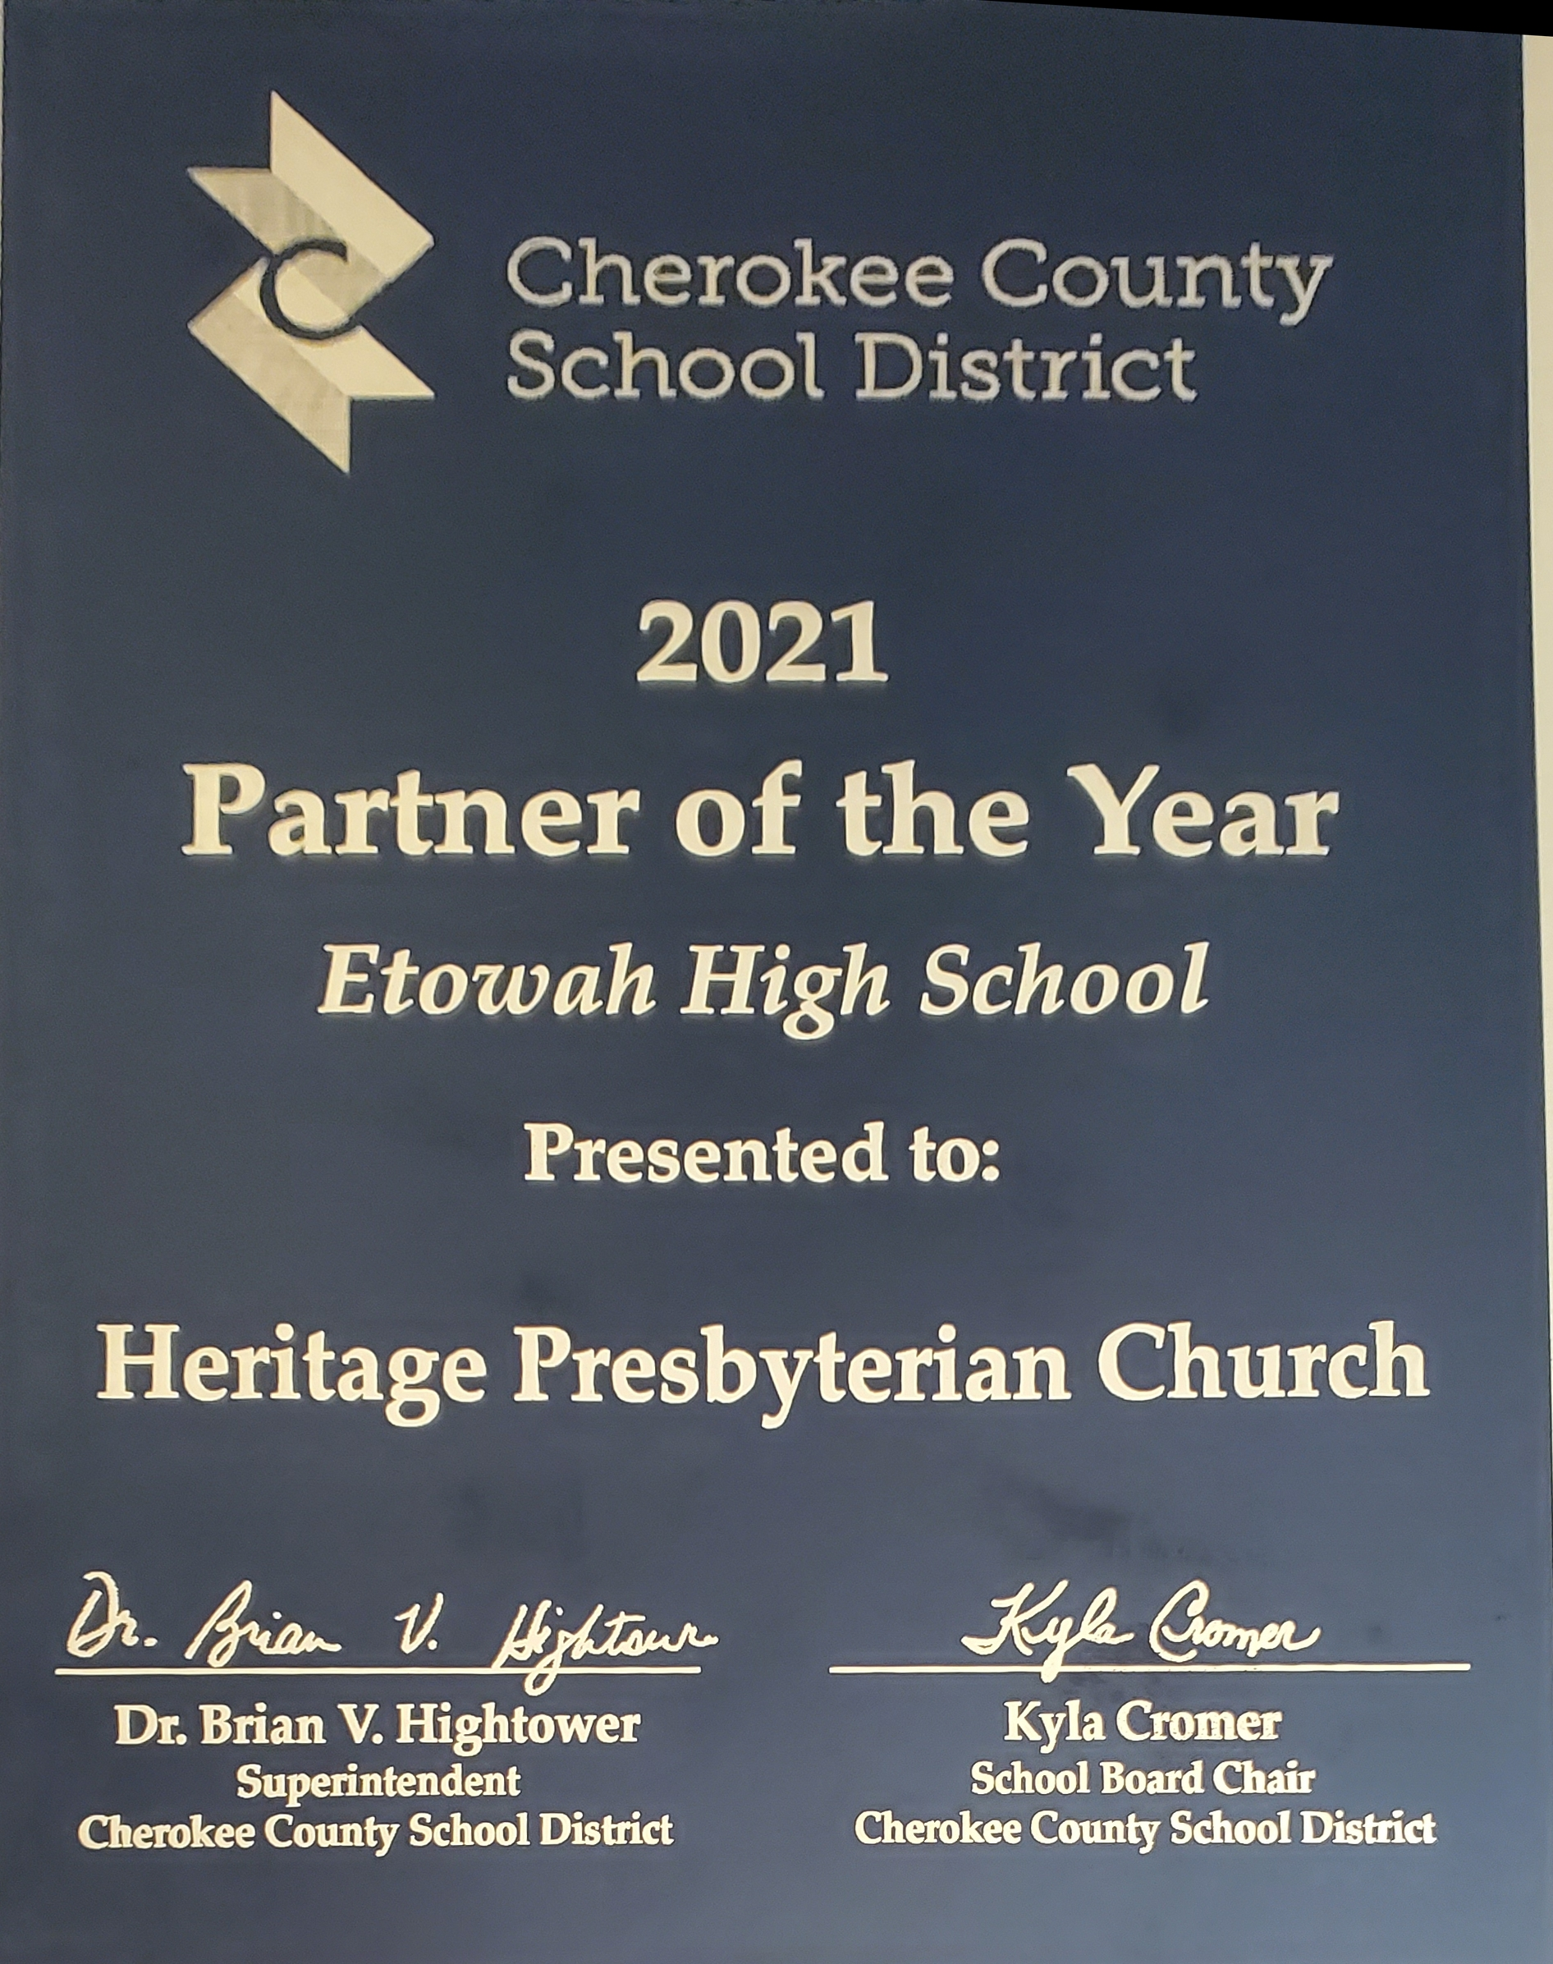
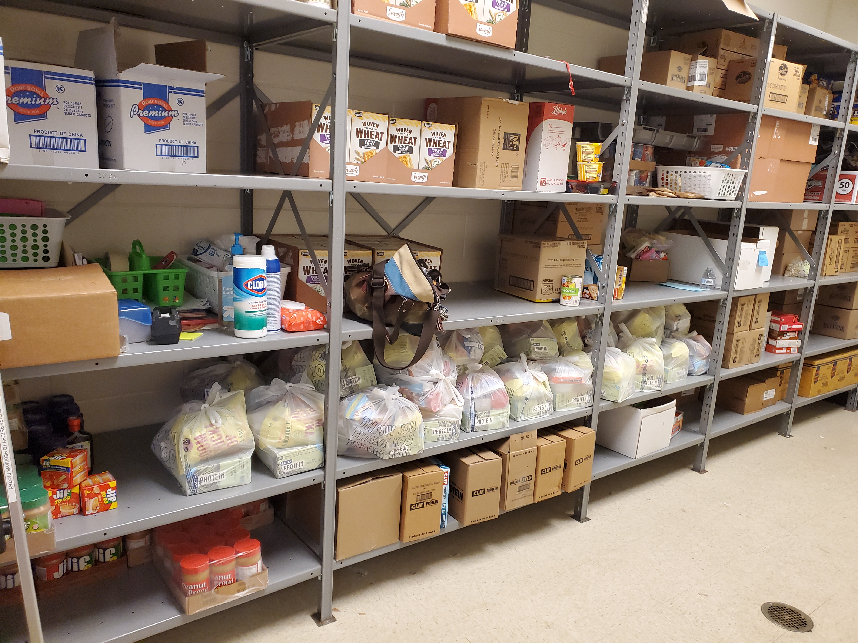
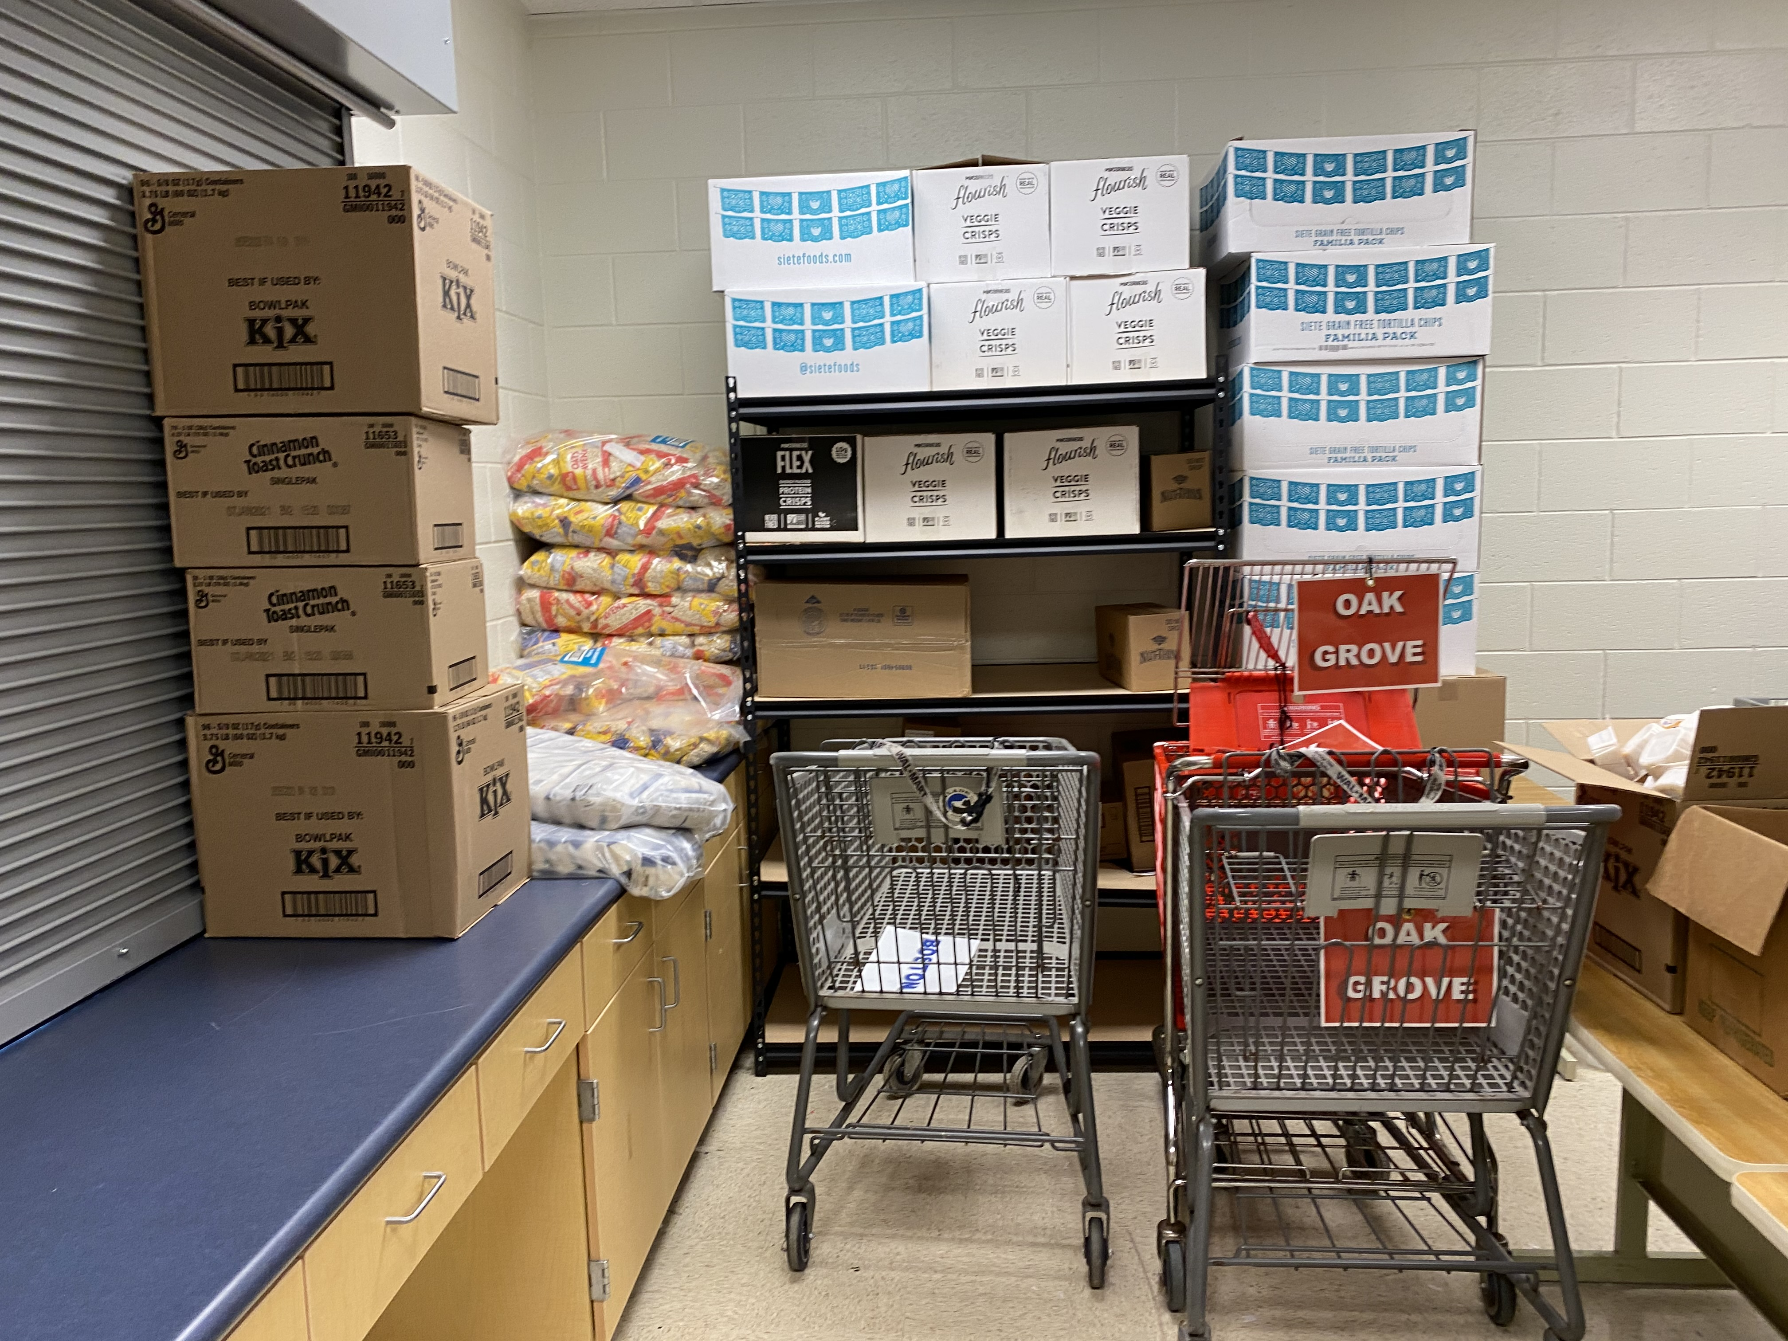
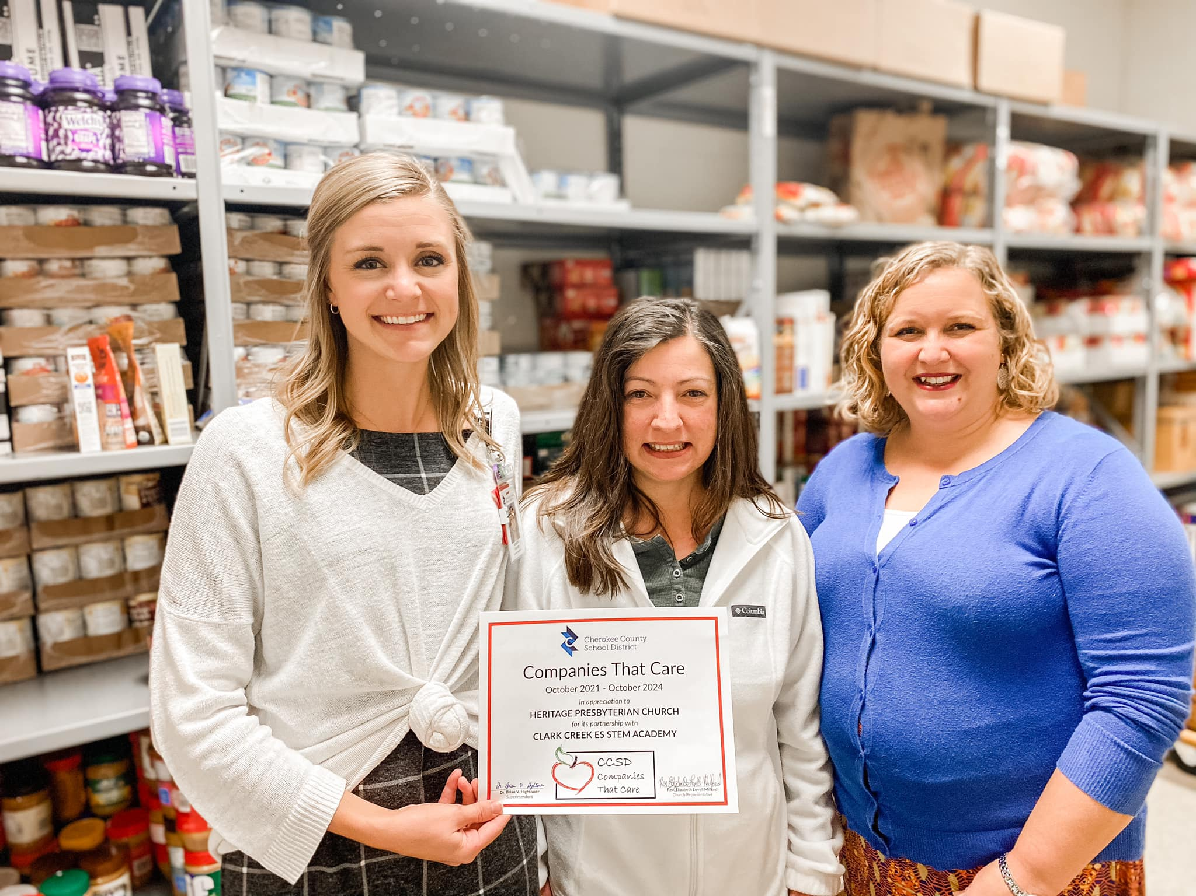
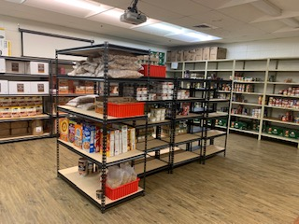
School Pantry – Weekend Bag Program
Heritage has assisted in establishing pantry rooms at three local Cherokee County schools;
Clark Creek Elementary School
Etowah High School (also serving ET Booth MS, Oak Grove ES, and Boston ES)
Woodstock High School (also serving Woodstock MS and Woodstock ES).
Our volunteers were the first service group invited back into the buildings to support students through this program at the beginning of the 2020-2021 school year.
C C E S
Etowah High School
2021
Partner of the Year
EHS
Cherokee County School District has recognized HPC as “Companies that Care” with both
EHS and CCES
WHS

Slide 18
Congregation, Community and Grant Funds 2020 – NOW Overview
Heritage committed in a large way at the beginning of the COVID-19 pandemic in March of 2020 to support our neighbors who were facing food insecurity issues. This could only have been accomplished through;
The dedicated giving of our HPC Congregation
Donations from community members and businesses
Several grants (ACFB, Cherokee County Board of Commissioners Office, FEMA, PDA, and United Way
These funds were applied to support food purchases, pay utilities, and make necessary infrastructure improvements/repairs.
All Pantries Food Purchase Totals
2020 - $35,000
2021 – $23,000
Notes:
Infrastructure Improvements
Door Mullion enhancement (to allow pallets to be pulled into the Fellowship Hall) - $1,500
Air Conditioner Replacement Fellowship Hall - $9,000
Air Conditioner Replacement Fellowship Hall - $9,000
Walk in Refrigerator Replacement - $8,500
Food Pantry Freezer Repairs - $610.00
Upcoming… Walk in Freezer Replacement - $15,000

Slide 19
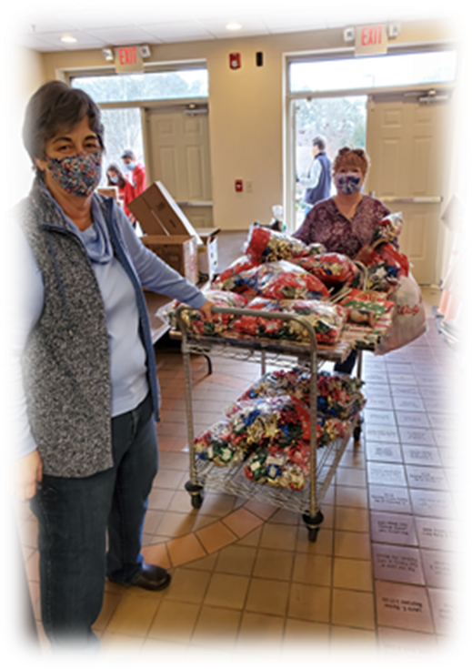
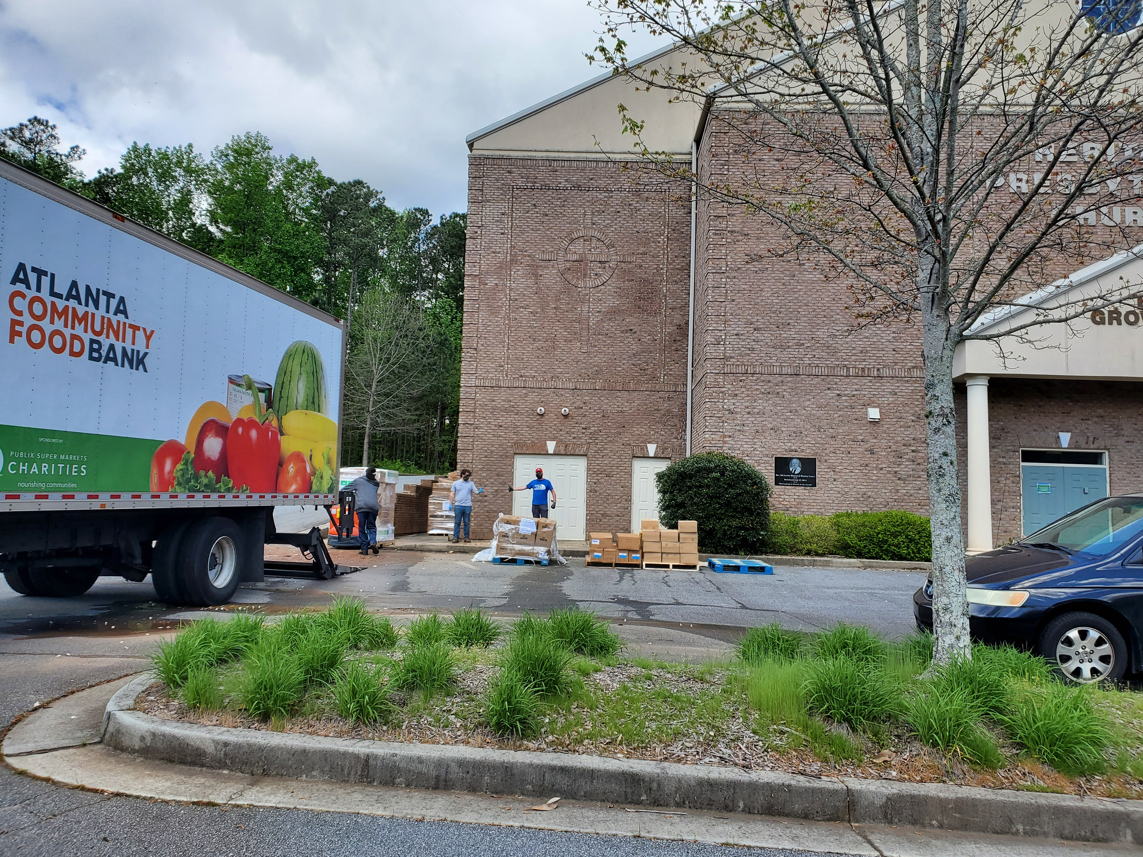
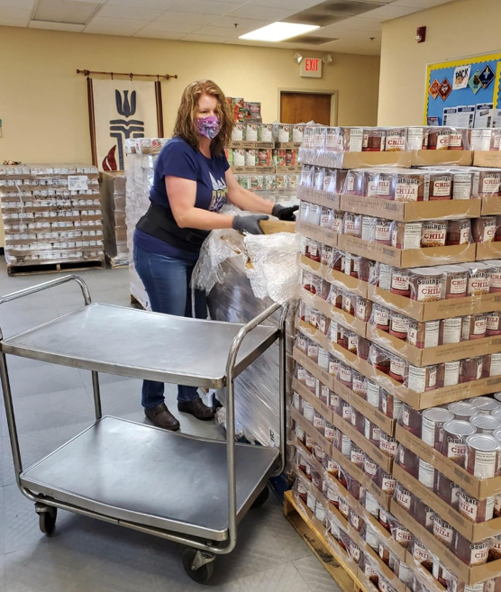
Dedicated Volunteers
Notes:
The volunteers of the JWEFP have consistently shown a high level of dedication to families in need of food assistance. In March of 2020 all volunteers felt the desire to help even more. Since the beginning of the pandemic, many changes needed to be made to increase service and stay safe for all involved.
Volunteers have contributed over 3,000 hours of service, six days a week to meet the needs of our community. Working to pack boxes, except deliveries, load cars, organize pallets, clean, and record keeping.

Slide 20
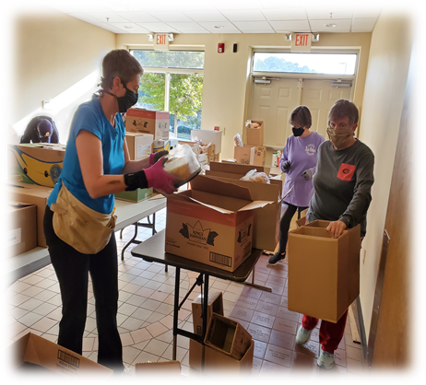
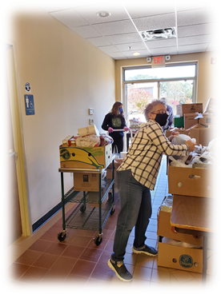
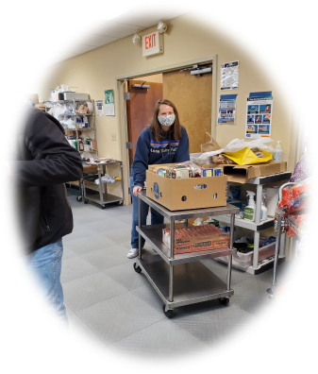
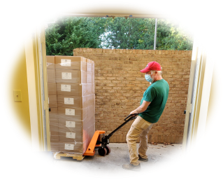
Dedicated Volunteers

